Slide 1
Accessible tools and data: Lessons from the Web
Andy Boughton
Abecasis Group Meeting
July 20, 2021

Slide 2
When everything is digital, who gets left behind?
“...websites, tools, and technologies are designed and developed so that people with disabilities can use them. More specifically, people can:
perceive, understand, navigate, and interact with the Web
contribute to the Web
Web accessibility encompasses all disabilities that affect access to the Web, including:
auditory [3.1%]
cognitive [6.3%]
neurological
physical [8.2%]
speech
visual [3.3%]”
[1] https://www.w3.org/WAI/fundamentals/accessibility-intro/
[2] https://www.interactiveaccessibility.com/accessibility-statistics (2012)

Slide 3
“Section 504 prohibits discrimination based on disability by federal agencies and recipients of federal assistance... applies to facilities... communications such as websites. So, if your organization receives federal funding or assistance, your website is required to be accessible.
the DOJ ... was considering proposing WCAG 2.0 Level AA as the accessibility standard for websites and web content.... The Revised 508 Standards are based on WCAG 2.0.
However, a final rule specifying technical standards under the ADA has not been adopted. ... if you’re subject to the ADA, you have more flexibility in determining how to make your website compliant with the ADA’s general requirements of nondiscrimination and effective communication.”
[1] https://www.section508.gov/blog/do-section-508-accessibility-standards-apply-to-mywebsite

Slide 4
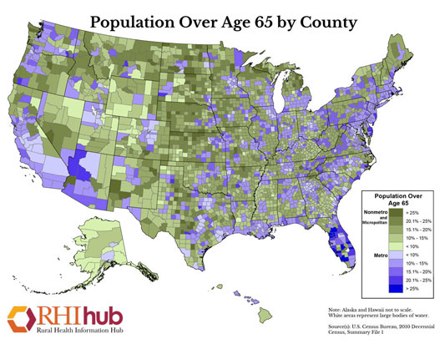
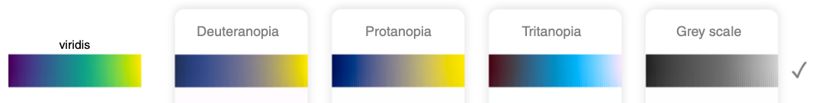
Accessibility helps everyone
Colorblind-friendly
Figures that print well in black and white
Low contrast issues
Reading phone screen in bright sunlight
Subtitles (CC)
Automatic transcripts of podcasts; captions for TV in restaurants
Text based communication (TDD)
Everyone texts now
Adapt to new types of technology
Mobile friendly websites, voice-activated, etc.
This benefits from the shift to REST APIs (separate content from rendering)
[1] https://www.ruralhealthinfo.org/toolkits/aging/1/demographics

Slide 5
A mouse-only UI?
^
v
Original: inscrutable. Why is there no context?
Couldn’t they have tried to align things?
The challenge: instrument control software for a light-sensitive experiment. Had to turn off the screen during the critical step.
Only one person knew what the buttons did.
A first draft added human friendly labels; this took up space and made buttons very hard to click in the dark
Second draft considered the physical limits for how it would be used
Modern alternatives: physical buttons, touch interface, VUI...
Aperture size
-
+
Revised: group controls together, add labels
Aperture size
Smaller
Larger
Final: add keyboard shortcuts (no mouse required), add alert sounds if a problem occurs

Slide 6
One goal, many pieces
Perceivable - Information and user interface components must be presentable to users in ways they can perceive.
Operable - User interface components and navigation must be operable.
Understandable - Information and the operation of user interface must be understandable.
Robust - Content must be robust enough that it can be interpreted reliably by a wide variety of user agents, including assistive technologies.
[1] https://www.w3.org/TR/UNDERSTANDING-WCAG20/intro.html

Slide 7
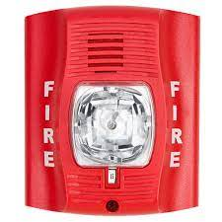
Auditory issues: considerations
Conference talks / lectures
Provide live captions/interpreters, or pre-typed notes
Provide alternatives where audio is critical
“Phone number to get login code”
Error messages/ alerts
Jeopardy video clue

Slide 8
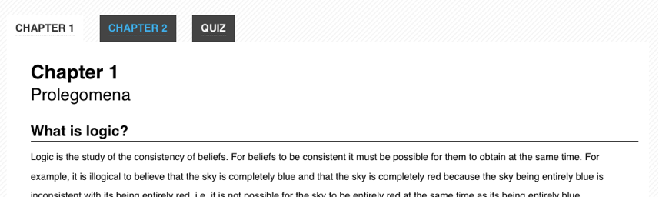
Physical (eg no mouse)
Ensure that form controls can be reached without a mouse, and in the order expected
AJAX forms should still use form tags for grouping
Keyboard tab order may not match the order of elements in HTML: ensure that users can reach form elements and buttons in a way that makes sense
Screen readers might not understand custom widgets or HTML canvas
“...Users might recognize it visually, but there are no machine-readable semantics for an assistive technology.” [2]
[1] https://dequeuniversity.com/checklists/web/custom-widgets
[2] https://developer.mozilla.org/en-US/docs/Web/Accessibility/An_overview_of_accessible_web_applications_and_widgets
[3] http://nomouse.org/

Slide 9
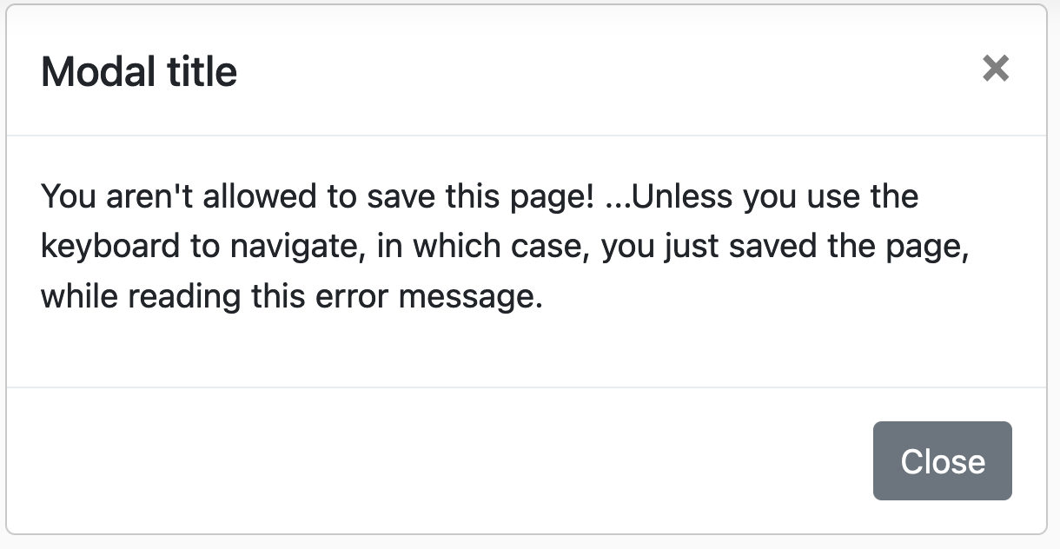
Keyboard users break the rules
Sometimes, UI is designed to only work with “mouse click” events. Keyboard users can bypass the expected rules.
Unreachable elements: some buttons cannot be used without a mouse
Opposite problem: Keyboard “traps” (can’t leave)
Common issues: modal dialogs; form validation that only disables the button
Pre-made widget libraries often include accessibility features built in
https://accessibility.18f.gov/keyboard/

Slide 10
Cognitive
There are many types of problem; this comes into play when writing tools with a wide audience
How to ensure informed consent from someone clicking a web page?
Common considerations:
Distinguishable (eg distraction-free layouts)
Readable (short, clear sentences)
Other language barriers?
The most nebulous of the WAI standards: https://www.w3.org/WAI/cognitive/
Research studies have domain-specific rules, eg informed consent
[1] https://research-compliance.umich.edu/informed-consent-guidelines

Slide 11
Vision: A complicated topic
Most interfaces are visual, so this is something that technology tends to focus on
Many possible aspects:
Color blindness / contrast issues
Screen readers
Features that shouldn’t be computer readable: CAPTCHAs

Slide 12
Forms of colorblindness
Three basic categories, each with several forms [1]:
Red-green: ~8% of males and ~0.5% of females of N. Eur descent
Blue-yellow
Complete
Heritable and X-linked (more common in males)
“If a submitted manuscript happens to go to three male reviewers of Northern European descent, the chance that at least one will be color blind is 22 percent.” [2]
There is a continuum: some people have partial loss
[1] https://www.nei.nih.gov/learn-about-eye-health/eye-conditions-and-diseases/color-blindness/types-color-blindness
[2] Wong, B. Points of view: Color blindness. Nat Methods 8, 441–441 (2011). (link)

Slide 13

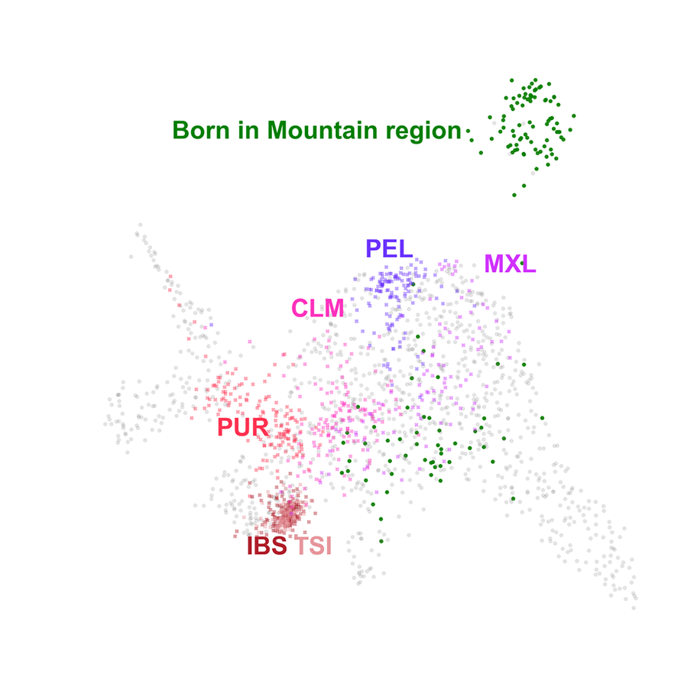
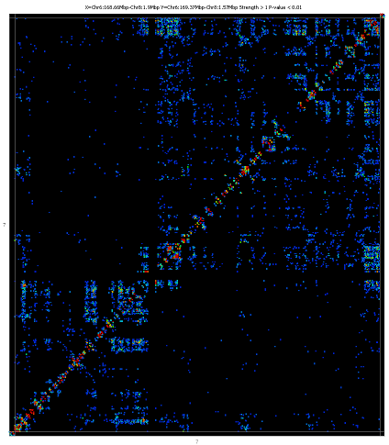
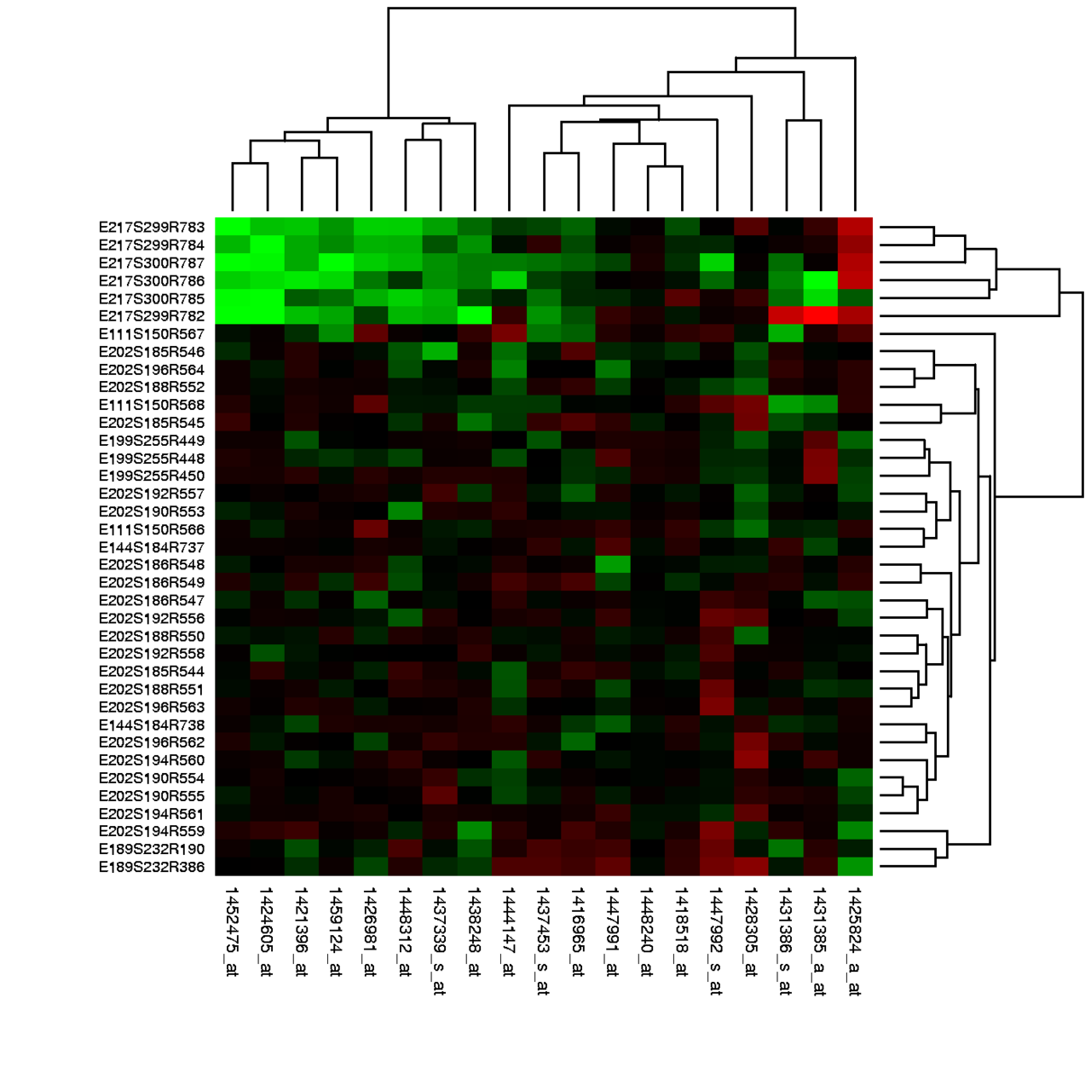
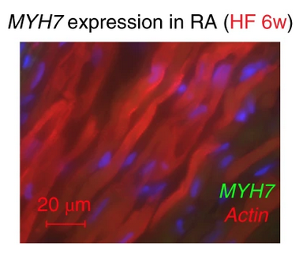
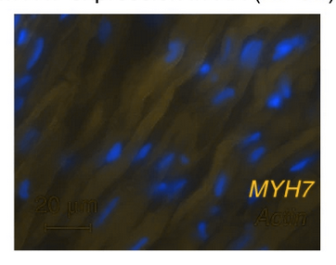
Colors Are Hard
[1] “HiC Heatmap”: https://www.bioinformatics.babraham.ac.uk/projects/seqmonk/Help/3%20Visualisation/3.2%20Figures%20and%20Graphs/3.2.12%20The%20HiC%20Heatmap%20Plot.html
[2] “Gene expression heatmap”: https://en.wikipedia.org/wiki/Heat_map#/media/File:Heatmap.png
[3] UMAP plots of populations structure (2020): https://journals.plos.org/plosgenetics/article?id=10.1371/journal.pgen.1008432
[4] It’s annual review season! https://www.nature.com/articles/s41588-018-0171-3/figures/4

Slide 14
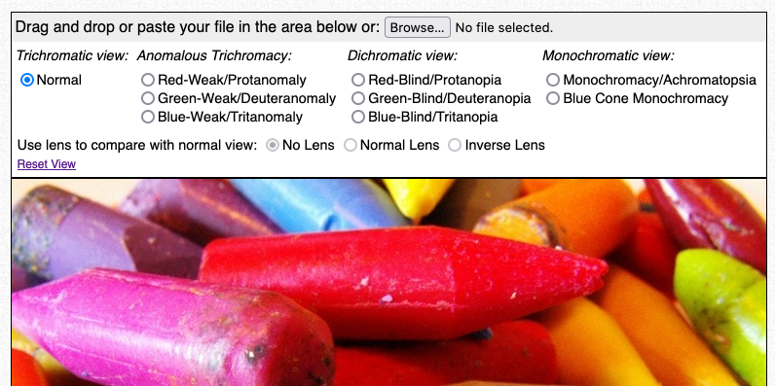
Experiencing colorblindness
Online “color-blind simulator” tools let you try any image
Firefox web browser has a built-in tool for web pages
Tool: https://www.color-blindness.com/coblis-color-blindness-simulator/

Slide 15
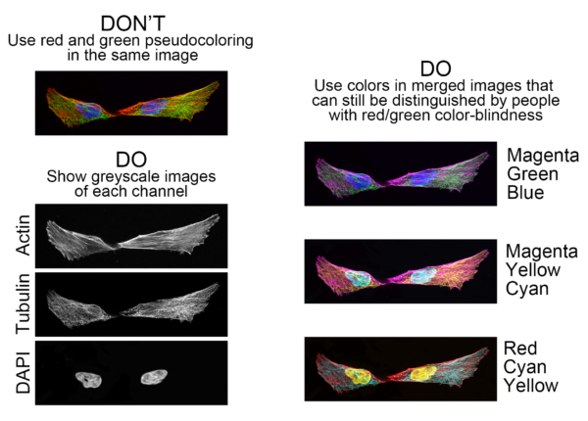
Improving colors: content matters
Consider what you are using color to convey
Combined image or separate pieces of information?
Choose a color scheme that reflects the type of data
Continuous
Sequential
Categorical
[1] https://www.ascb.org/science-news/how-to-make-scientific-figures-accessible-to-readers-with-color-blindness/
[2] “Semiology of graphics”: https://karlsluis.medium.com/before-tufte-there-was-bertin-63af71ceaa62
[3] “Grammar of Graphics”: https://www.amazon.com/Grammar-Graphics-Statistics-Computing/dp/0387245448

Slide 16
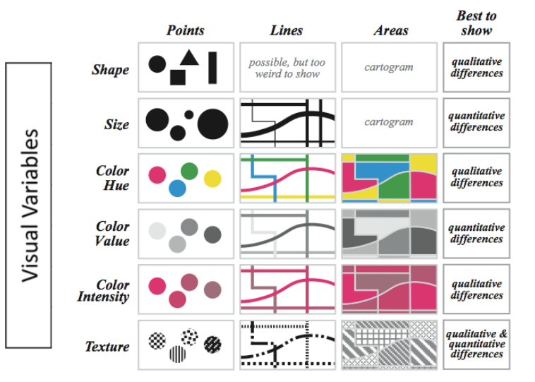
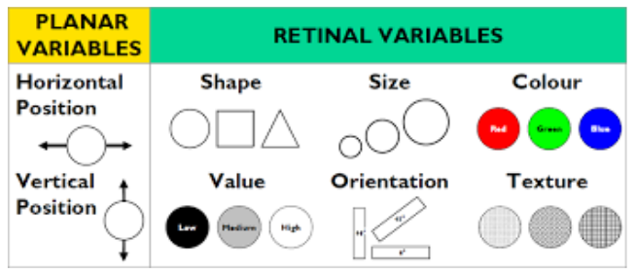
Go Beyond Color
http://euclid.psych.yorku.ca/www/psy6135/lectures/Language.pdf

Slide 17
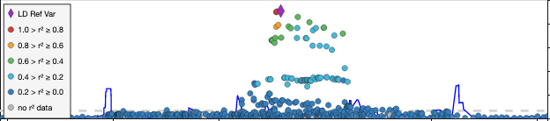
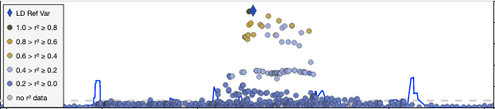
Application to our own tools: LocusZoom.js
Default LocusZoom color palette is ok, but not great with red-green colorblindness
Can we find a better color palette?
Normal vision
Protanopia (red-green)

Slide 18
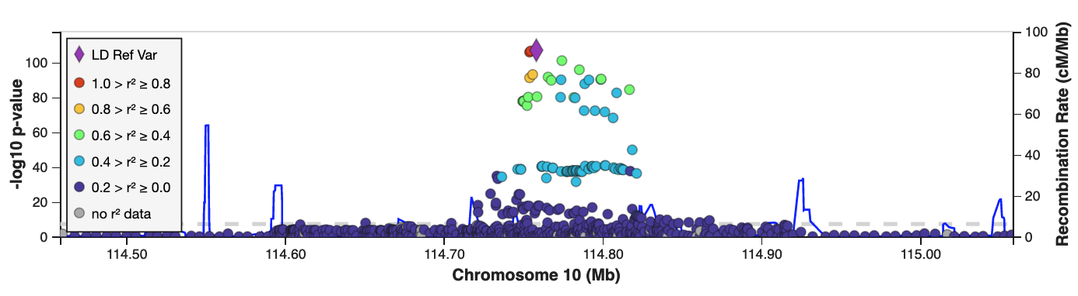
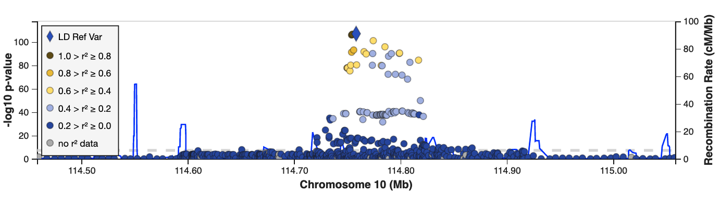

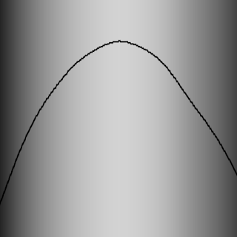
New LZ.js color map: Turbo
Normal vision
More saturated colors
Smoother luminosity gradient than Jet
Protanopia (red-green)
[1] https://ai.googleblog.com/2019/08/turbo-improved-rainbow-colormap-for.html

Slide 19
Try it out: Screen Readers
Demonstration videos
https://twitter.com/Kristy_Viers/status/1287189581926981634
https://www.youtube.com/watch?v=_B1o6DyLCVY
How to use macOS “VoiceOver” (built in):
https://dequeuniversity.com/screenreaders/voiceover-keyboard-shortcuts
Caveat: most users are on Windows: https://webaim.org/blog/three-things-voiceover/
Windows 10 “Narrator”:
https://support.microsoft.com/en-us/windows/complete-guide-to-narrator-e4397a0d-ef4f-b386-d8ae-c172f109bdb1

Slide 20
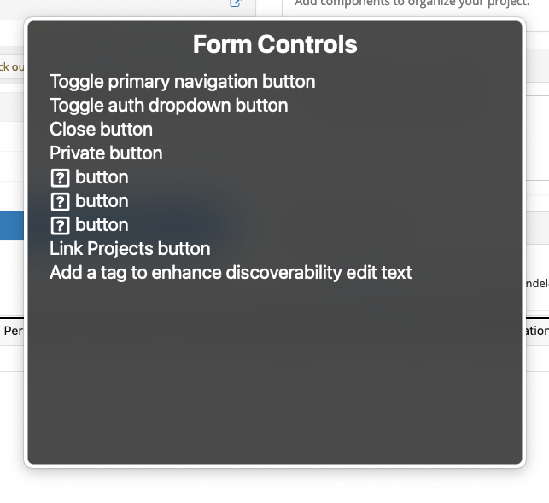
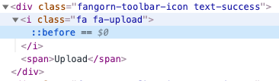
Use semantic markup!
Using built-in HTML tags lets the browser add accessibility features automatically
“You can click this”
“Here is a label for this text”
Code should indicate interactive elements
Links for navigation
Buttons for click/action
Tab order
Icons or visual-only elements can render your controls invisible to blind people
<button>
<i aria-hidden="true" class="fas fa-upload”>
Upload
</button>
[1] https://fontawesome.com/v5.15/how-to-use/on-the-web/other-topics/accessibility

Slide 21
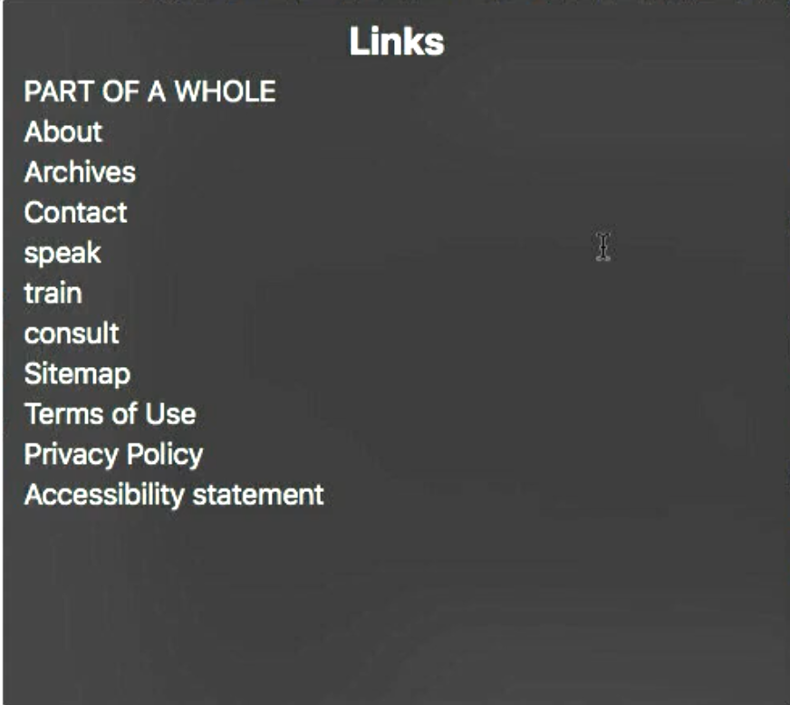
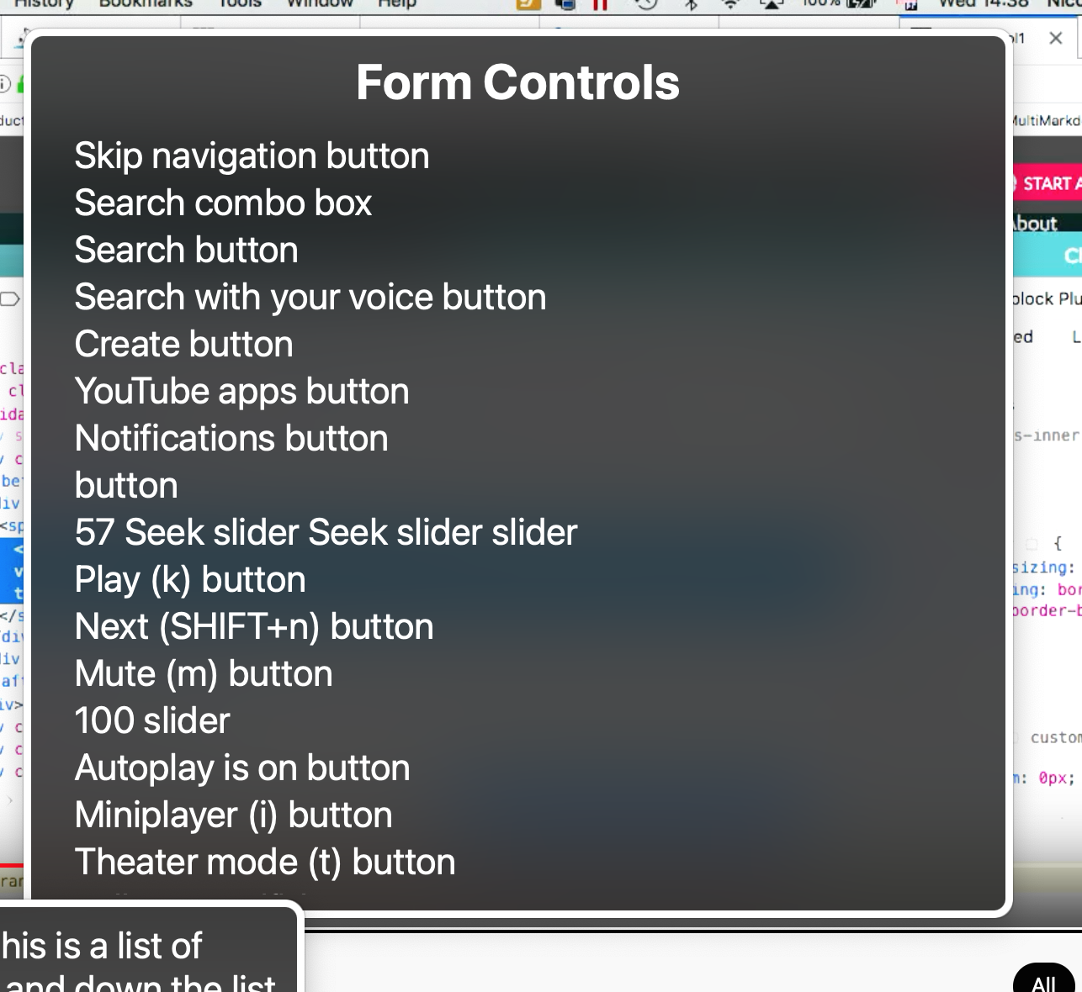
Help the user find content
Landmarks: Use HTML tags for navigation vs section
Hierarchical headings give a sense of page outline (H1, H2...)
ARIA roles that indicate nested UI (tabs, flyouts...)
Provide context-specific description
Link text should describe contents, not just say “click here”
Form controls: descriptions include keyboard shortcuts or current state where applicable
The VoiceOver “rotor”: quickly find sections of the page

Slide 22
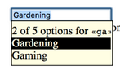
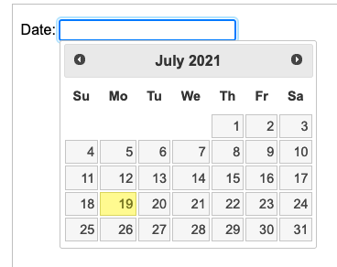
When semantic markup isn’t possible
Custom HTML widgets require telling the browser how to use the widget
ARIA roles are special HTML attributes to identify how pieces interact
The spec is... complicated. Read it as you go.
[1] https://www.accessibility-developer-guide.com/examples/widgets/autosuggest/

Slide 23
Beyond visualization
Sonification (turning patterns into music)
https://www.youtube.com/watch?v=3EXvR1shVFQ
WebPlotDigitizer: Extract datapoints by tracing a figure (*)
https://apps.automeris.io/wpd/
Show the data!
Tabula: Extract data from tables: https://tabula.technology/
Supplemental files / data repositories
(*) Some authors get really mad when you access raw data this way, even just to check the results in that paper.

Slide 24
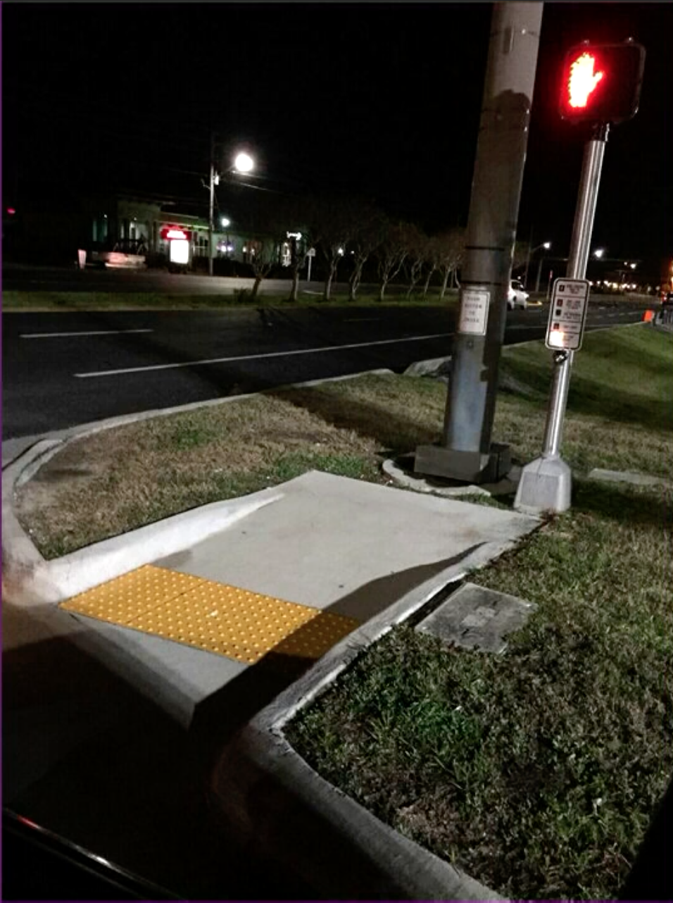
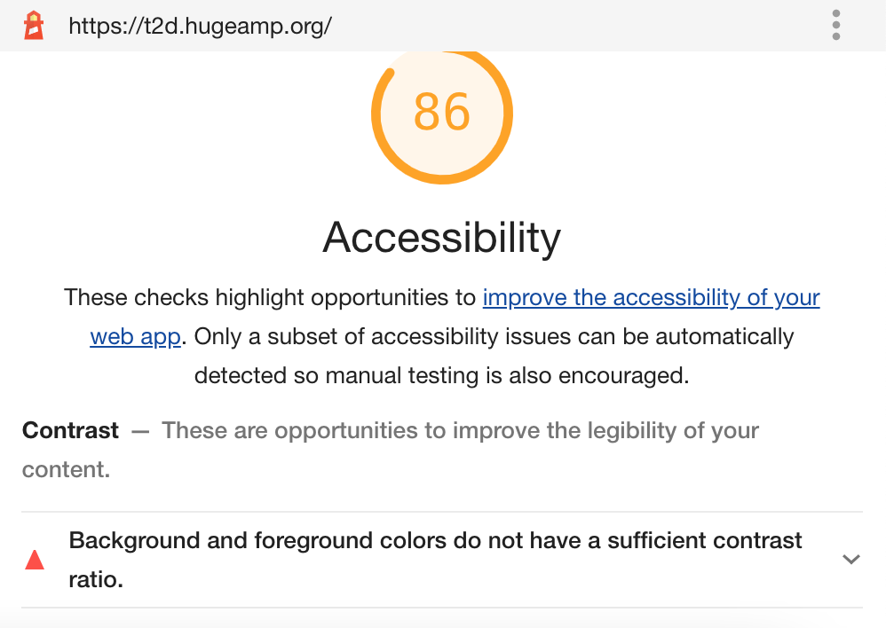

Automated checkers
Browser based tools to check website
Chrome extension: https://wave.webaim.org/
Did well in UK test: https://tenon.io/
Built into Google Chrome: https://developers.google.com/web/tools/lighthouse
Automated tools that integrate into CI
https://github.com/dequelabs/axe-core
https://www.npmjs.com/package/vue-axe
Not a substitute for human testing. Tend to emphasize what can be easily measurable
UK study: best tools found ~38% of barriers [1]
Missing one big problem can break everything
[1] https://alphagov.github.io/accessibility-tool-audit/test-cases.html

Slide 25
Some good examples
Places that have a stake in compliance
Federal Agencies: https://18f.gsa.gov/
Banks and Airlines (operate in many jurisdictions, lots of $$: lawsuit targets)
https://www.delta.com/
https://www.chase.com/
Advocacy organizations: lead by example
https://globalaccessibilityawarenessday.org/#site-content

Slide 26
References
“Practical Hands-on accessibility”- good intro video! https://www.youtube.com/watch?v=_B1o6DyLCVY
Helpful communities
https://globalaccessibilityawarenessday.org/
https://www.section508.gov/create/software-websites
GSA Guide: https://accessibility.18f.gov/
The “no mouse” challenge: http://nomouse.org/
Standards and guidelines
WCAG: https://www.w3.org/TR/UNDERSTANDING-WCAG20/intro.html
WAI-ARIA: https://www.w3.org/WAI/standards-guidelines/aria/

Slide 27
Sometimes, you just want data
Don’t lock people into a single preferred user interface

Slide 28
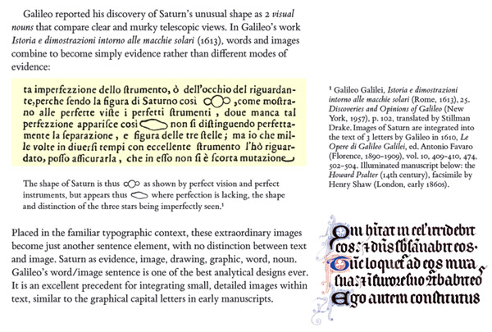
Claims and evidence
Papers have long incorporated claims and evidence together
As methods become more complex, it is hard to follow up just from figures
Access to the raw data is needed
Edward Tufte, Beautiful Evidence (2006)

Slide 29
“We selected 41 open access papers... and executed the R code....
46 out of 97 reproduced figures deviated from the original figures on a deeper level, e.g. graphs had different curves, and key numbers were missing or different...
The code of two papers ran without any issues, 33 had resolvable issues, and two were partially executable, i.e. the code produced output but also had issues that we could not resolve... The code of 15 papers contained issues that required contacting the corresponding author.”
Konkol, M., Kray, C. & Pfeiffer, M. Computational reproducibility in geoscientific papers: Insights from a series of studies with geoscientists and a reproduction study. International Journal of Geographical Information Science 33, 408–429 (2019). (link)

Slide 30
Considerations for sharing
FAIR Principles
Findable: Indexed by search, and persistent links
Accessible: Respect access rules, but not just “available upon request”
Interoperable: Integrate with tools and workflows
Reusable: Maintain provenance and vocabulary
Resources and best practices vary by field; ask around!
Data Sharing and Management Snafu in 3 Short Acts: https://www.youtube.com/watch?v=66oNv_DJuPc

Slide 31
Where to share: Methods and code
Genetic data (ask Heather, Albert, Tom, etc how to use these!)
dbSNP
dbGaP
...others?
Summary results
EBI eQTL Catalogue
EBI GWAS Catalogue
Source code/ methods
GitHub (“living” version of source code + provenance)
Zenodo (auto-generate author list and citable DOI from a GitHub repo; archives maintained by CERN)
Example from collaborators: https://pubmed.ncbi.nlm.nih.gov/32213349/ - https://github.com/ParkerLab/ataqv/

Slide 32

Summary
Accessibility has many pieces
There is no substitute for human testing - yet
Interactive widgets are harder to write, and MUCH harder to make accessible
Know your requirements up front, and plan for accessibility during initial development

